Slide 1
Status of CEPT preparations for WRC-19
Alexander Kühn (CPG-19 Chairman)
September 2016

Slide 2
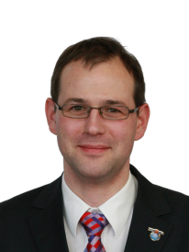
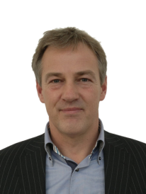
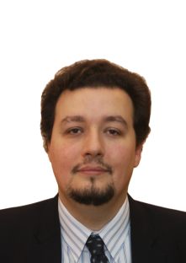
Structure of CPG19
The Conference Preparatory Group (CPG19) of CEPT/ECC is responsible for developing the ECPs and Briefs for WRC-19 and RA-19
The CPG management team has been confirmed by the 1st meeting of CPG19:
Chairman: Alexander Kühn, Germany
Vice-Chairmen: Gerlof Osinga, The Netherlands
Alexandre Vallet, France
Secretary: Karsten Buckwitz, Germany

Slide 3
CPG19 Project Teams

Slide 4
CPG19 Deliverables
For both, WRC-19 and the RA-19:
European Common Proposals (ECPs)
At least 10 administrations in support
No more than 6 opposing – as a general guideline
CEPT Briefs
Describe each agenda item
Contains the CEPT view – agreed by consensus at each stage
CEPT co-ordination in ITU-R meetings
Agreed contributions (also for non-WRC issues)
Co-ordination on lines to take

Slide 5
Agenda Item 1.1
Issue: to consider an allocation of the frequency band 50-54 MHz to the amateur service in Region 1, in accordance with Resolution 658 (WRC-15);
Preliminary CEPT position:
CEPT Coordinator: Mr Hans Blondeel Timmerman (Netherlands)

Slide 6
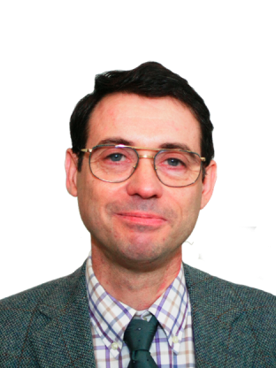
Agenda Item 1.2
Issue: to consider in-band power limits for earth stations operating in the mobile-satellite service, meteorological-satellite service and Earth exploration-satellite service in the frequency bands 401-403 MHz and 399.9-400.05 MHz, in accordance with Resolution 765 (WRC-15);
Preliminary CEPT position:
CEPT Coordinator: Mr Jean Pla (France)

Slide 7
Agenda Item 1.3
Issue: to consider possible upgrading of the secondary allocation to the meteorological-satellite service (space-to-Earth) to primary status and a possible primary allocation to the Earth exploration-satellite service (space-to-Earth) in the frequency band 460-470 MHz, in accordance with Resolution 766 (WRC-15);
Preliminary CEPT position:
Acting CEPT Coordinator: Ralf Ewald (Germany)

Slide 8
Agenda Item 1.4 (developed at CPG PTB#1)
Issue: to consider the results of studies in accordance with Resolution 557 (WRC-15), and review, and revise if necessary, the limitations mentioned in Annex 7 to Appendix 30 (Rev.WRC-15), while ensuring the protection of, and without imposing additional constraints on, assignments in the Plan and the List and the future development of the broadcasting-satellite service within the Plan, and existing and planned fixed-satellite service networks;
Preliminary CEPT position:
CEPT supports the studies to potential review limitations in Annex 7 to RR Appendix 30 (Rev.WRC-12), while ensuring the protection of, and without imposing additional constraints on, assignments in the Plan and in the List and the future of BSS networks mentioned in recognizing c) of Resolution 557 (WRC-15) and existing and planned FSS networks mentioned in recognizing d) of Resolution 557 (WRC-15).
CEPT reaffirms, inter alia considering that 74 Administrations are having frequency assignments within the allowable portions of Table 2, that it is necessary to ensure the protection of, and not impose additional constraints on, assignments in the Plan and the List and the future development of the broadcasting-satellite service within the Plan, and existing and planned fixed-satellite service networks.
The preliminary CEPT positions for the different Annex 7 Limitations will be developed in the course of this study cycle.
Acting CEPT Coordinator: PTB chairperson

Slide 9
Agenda Item 1.5 (developed at CPG PTB#1)
Issue: to consider the use of the frequency bands 17.7-19.7 GHz (space-to-Earth) and 27.5-29.5 GHz (Earth-to-space) by earth stations in motion communicating with geostationary space stations in the fixed-satellite service and take appropriate action, in accordance with Resolution 158 (WRC-15);
Preliminary CEPT position:
CEPT supports to develop a regulatory framework for the operation of ESIMs in the bands 17.7-19.7 GHz and 27.5-29.5 GHz, while ensuring protection of, and not imposing undue constraints on, services allocated in those frequency bands.
Regarding the 17.7-19.7 GHz band, the CEPT is of the view that ESIM should not claim protection from the fixed and mobile services in the band.
Regarding the 27.5-29.5 GHz band, the CEPT supports studying appropriate sharing techniques, including e.i.r.p. or pfd values for ESIMs in order to protect the fixed and mobile services allocated in the bands.
CEPT Coordinator: Mr Mario Neri (United Kingdom)

Slide 10
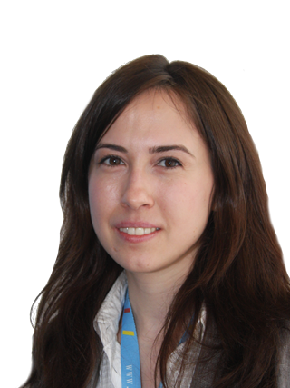
Agenda Item 1.6 (developed at CPG PTB#1)
Issue: to consider the development of a regulatory framework for non-GSO FSS satellite systems that may operate in the frequency bands 37.5-39.5 GHz (s-E), 39.5-42.5 GHz (s-E), 47.2-50.2 GHz (E-s) and 50.4-51.4 GHz (E-s), in accordance with Resolution 159 (WRC-15);
Preliminary CEPT position:
CEPT supports the studies of technical and operational issues and regulatory provisions for the operation of non-GSO FSS satellite systems in the frequency bands 37.5-42.5 GHz (space-to-Earth) and 47.2-48.9 GHz (limited to feeder links only), 48.9-50.2 GHz and 50.4-51.4 GHz (all Earth-to-space) in accordance of Resolution 159 (WRC-15).
Acting CEPT Coordinator: PTB chairperson

Slide 11
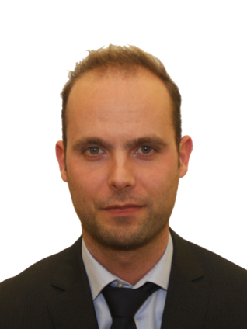
Agenda Item 1.7
Issue: to study the spectrum needs for telemetry, tracking and command in the space operation service for non-GSO satellites with short duration missions, to assess the suitability of existing allocations to the space operation service and, if necessary, to consider new allocations, in accordance with Resolution 659 (WRC-15);
Preliminary CEPT position:
CEPT Coordinator: Mr Wouter Jan Ubbels (The Netherlands)

Slide 12
Agenda Item 1.8
Issue: to consider possible regulatory actions to support Global Maritime Distress Safety Systems (GMDSS) modernization and to support the introduction of additional satellite systems into the GMDSS, in accordance with Resolution 359 (Rev.WRC-15);
Preliminary CEPT position:
CEPT co-Coordinators: Talayeh Hezareh (Germany), Christian Rissone (France)

Slide 13
Agenda Item 1.9.1
Issue: to consider, based on the results of ITU-R studies: regulatory actions within the frequency band 156-162.05 MHz for autonomous maritime radio devices to protect the GMDSS and automatic identifications system (AIS), in accordance with Resolution 362 (WRC-15);
Preliminary CEPT position:
CEPT Coordinator: Heinrich Peters (Germany)

Slide 14
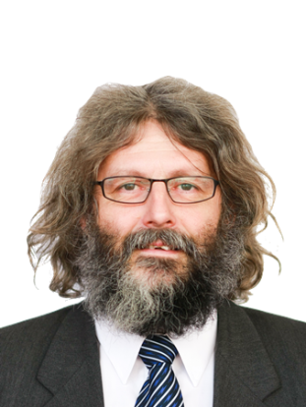
Agenda Item 1.9.2
Issue: to consider, based on the results of ITU-R studies modifications of the Radio Regulations, including new spectrum allocations to the maritime mobile-satellite service (Earth to space and space-to-Earth), preferably within the frequency bands 156.0125-157.4375 MHz and 160.6125-162.0375 MHz of Appendix 18, to enable a new VHF data exchange system (VDES) satellite component, while ensuring that this component will not degrade the current terrestrial VDES components, applications specific messages (ASM) and AIS operations and not impose any additional constraints on existing services in these and adjacent frequency bands as stated in recognizing d) and e) of Resolution 360 (Rev.WRC-15);
Preliminary CEPT position:
Acting CEPT Coordinator: PTC chairman

Slide 15
Agenda Item 1.10
Issue: to consider spectrum needs and regulatory provisions for the introduction and use of the Global Aeronautical Distress and Safety System (GADSS), in accordance with Resolution 426 (WRC-15);
Preliminary CEPT position:
Acting CEPT Coordinator: PTC chairman

Slide 16
Agenda Item 1.11
Issue: to take necessary actions, as appropriate, to facilitate global or regional harmonized frequency bands to support railway radiocommunication systems between train and trackside within existing mobile service allocations, in accordance with Resolution 236 (WRC-15);
Preliminary CEPT position:
CEPT Coordinator: Zaza Gonjilashvili (Georgia)

Slide 17
Agenda Item 1.12
Issue: to consider possible global or regional harmonized frequency bands, to the maximum extent possible, for the implementation of evolving Intelligent Transport Systems (ITS) under existing mobile-service allocations, in accordance with Resolution 237 (WRC-15);
Preliminary CEPT position:
CEPT Co-coordinators: Oliver Pellay (France), Bettina Erdem (Germany)

Slide 18
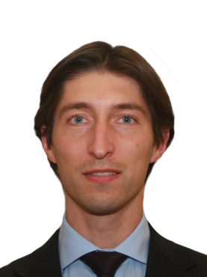
Agenda Item 1.13 (developed at ECC PT1#53)
Issue: to consider identification of frequency bands for the future development of International Mobile Telecommunications (IMT), including possible additional allocations to the mobile service on a primary basis, in accordance with Resolution 238 (WRC-15);
Preliminary CEPT position:
CEPT supports studies on IMT spectrum needs in the range 24.25-86 GHz and sharing and compatibility studies for the bands listed in Resolves 2 of Resolution 238.
CEPT supports the identification of global bands for IMT among the bands listed in Resolves 2 of Resolution 238, taking into account the results of sharing and compatibility studies with existing services.
CEPT Coordinator: Robert Cooper (G),
coordination team: Vladislav Sorokin (RUS), Sarunas Oberauskas (LTU)

Slide 19
Agenda Item 1.14
Issue: to consider, on the basis of ITU-R studies in accordance with Resolution 160 (WRC-15), appropriate regulatory actions for high-altitude platform stations (HAPS), within existing fixed-service allocations
Preliminary CEPT position:
CEPT Coordinator: Nasarat Ali (United Kingdom)

Slide 20
Agenda Item 1.15
Issue: to consider identification of frequency bands for use by administrations for the land-mobile and fixed services applications operating in the frequency range 275-450 GHz, in accordance with Resolution 767 (WRC-15);
Preliminary CEPT position:
CEPT Coordinator: Sebastian Rey (Germany)

Slide 21
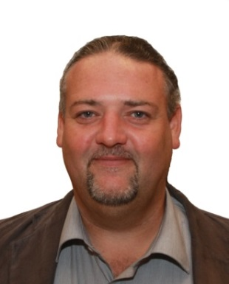
Agenda Item 1.16
Issue: to consider issues related to wireless access systems, including radio local area networks (WAS/RLAN), in the frequency bands between 5 150 MHz and 5 925 MHz, and take the appropriate regulatory actions, including additional spectrum allocations to the mobile service, in accordance with Resolution 239 (WRC-15);
Preliminary CEPT position:
CEPT Coordinator: Andrew Gowans (United Kingdom)

Slide 22
Agenda Item 2
Issue: to examine the revised ITU-R Recommendations incorporated by reference in the Radio Regulations communicated by the Radiocommunication Assembly, in accordance with Resolution 28 (Rev.WRC-15), and to decide whether or not to update the corresponding references in the Radio Regulations, in accordance with the principles contained in Annex 1 to Resolution 27 (Rev.WRC-12);
Preliminary CEPT position:
CEPT Coordinator: Karel Antousek (Czech Republic)

Slide 23
Agenda Item 4
Issue: in accordance with Resolution 95 (Rev.WRC-07), to review the resolutions and recommendations of previous conferences with a view to their possible revision, replacement or abrogation;
Preliminary CEPT position:
CEPT Coordinator: Karel Antousek (Czech Republic)

Slide 24
Agenda Item 7 (developed at CPG PTB#1)
.
Issue: to consider possible changes, and other options, in response to Resolution 86 (Rev. Marrakesh, 2002) of the Plenipotentiary Conference, an advance publication, coordination, notification and recording procedures for frequency assignments pertaining to satellite networks, in accordance with Resolution 86 (Rev.WRC‑07) to facilitate rational, efficient, and economical use of radio frequencies and any associated orbits, including the geostationary‑satellite orbit.
Preliminary CEPT position:
CEPT is studying possible improvements of the coordination and notification procedures for space services. CEPT supports retaining the current process of continuing evolution at successive WRCs of the regime governing space services. CEPT intends to develop specific positions susceptible to bring improvement to the regulatory process.
CEPT favours the review of any RR provision which can bring accurate solutions to specific detected inconsistencies and develop new improved provisions with emphasis on solving the most urgent issues, i.e. well
characterized issues whose improvement is urgent and impacting
CEPT Coordinator: Anna Marklund (Sweden)

Slide 25
Agenda Item 7 (developed at CPG PTB#1)
Issue A: Factors related to the BIU of frequency assignments of non-GSO systems subject to coordination
Preliminary CEPT position:
CEPT supports studies with the view of finding a possible solution to it. Elements linked to a minimum number of satellites to be deployed and a phased approach regarding the bringing into use (BIU) may be taken into account.
CEPT Coordinator: Anna Marklund (Sweden)

Slide 26
Agenda Item 7 (developed at CPG PTB#1)
Issue B: Modification (characteristics reduction) of a recorded assignment under RR AP 30 and 30A Regions 1 & 3 List
Preliminary CEPT position:
CEPT supports studies towards a possible modification of certain specific characteristics (i.e., reduction of service areas, frequencies or polarization usage) of an assignment after it has been successfully recorded in the RR Appendices 30, 30A Regions 1 & 3 List, with the purpose to better reflect the actual situation and thus increase the efficiency of spectrum use.
CEPT Coordinator: Anna Marklund (Sweden)

Slide 27
Agenda Item 7 (developed at CPG PTB#1)
Issue C: Discrepancy and/or inconsistency between the regulatory provisions dealing with any changes to the characteristics of an assignment
Preliminary CEPT position:
CEPT supports studies towards possibility of alignment between the wordings in paragraph 8.13 of Article 8 of RR Appendix 30B and No. 11.43A of RR Article 11 while ensuring that this alignment should not change current regulatory practice.
CEPT Coordinator: Anna Marklund (Sweden)

Slide 28
Agenda Item 7 (developed at CPG PTB#1)
Issue XX: Application of coordination arc in the Ka band, to determine coordination arc requirements between FSS and other satellite services
Preliminary CEPT position:
СEPT supports to study and analyse the introduction of the coordination arc mechanism to determine the coordination requirements between mobile-satellite service and fixed-satellite service (FSS vs MSS) geostationary satellite networks and between MSS geostationary satellite networks (MSS vs MSS), in the portions of the Ka band where both services, FSS and MSS, are allocated. Coordination arc criteria would substitute the ΔT/T > 6% criteria that currently applies, improving and making more efficient the coordination procedures, while keeping the possibility for Administrations to request ΔT/T criteria under RR No. 9.41. Consideration should be given to whether this approach would apply to MSS secondary frequency assignments.
CEPT considers that this matter should be studied as an issue of WRC-19 agenda item 7.
CEPT Coordinator: Anna Marklund (Sweden)

Slide 29
Agenda Item 7 (developed at CPG PTB#1)
Issue YY: Updating the reference situation for networks under appendices 30 and 30a when provisional recording is used
Preliminary CEPT position:
CEPT supports that when a network enters the List under § 4.1.18 or 4.2.21A of RR Appendix 30 or 30A, the reference situation of the “victim” network shall only be updated if the Bureau is informed that the agreement has been obtained. CEPT suggests to modify § 4.1.18 to reflect this view.
CEPT Coordinator: Anna Marklund (Sweden)

Slide 30
Agenda Item 7 (developed at CPG PTB#1)
Issue ZZ: Identification of those specific satellite networks and systems with which Coordination needs to be effected under Nos. 9.11A, 9.12, 9.12A and 9.13 or 9.21
Preliminary CEPT position:
СEPT proposes that the Bureau publish in the CR/D special section the “definitive lists” of those specific GSO networks or non-GSO systems, as appropriate, with which coordination under Nos. 9.11A, 9.12, 9.12A and 9.13 or under No. 9.21 needs to be effected, similarly to what is currently done under the provisions of No. 9.36.2.
CEPT believes that, once the relevant software currently used by the Bureau will be amended as needed, such an approach would not significantly increase the daily workload of the Bureau for producing such lists. In fact, the Bureau carries out a similar analysis to produce the list of Administrations currently published in the BR IFIC under the provisions of No. 9.36.1; the proposed changes would just modify the details published in the BR IFIC, together with simplifying the administrative burden currently born by many Administrations.
CEPT Coordinator: Anna Marklund (Sweden)

Slide 31
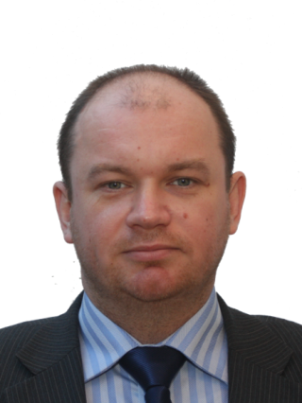
Agenda Item 8
Issue: to consider and take appropriate action on requests from administrations to delete their country footnotes or to have their country name deleted from footnotes, if no longer required, taking into account Resolution 26 (Rev.WRC-07);
Preliminary CEPT position:
CEPT Coordinator: Dmytro Protsenko (Ukraine)

Slide 32
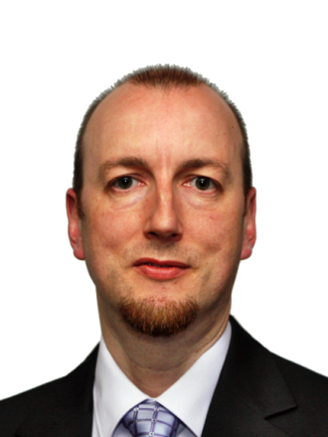
Agenda Item 9.1.1 (developed at ECC PT1#53)
Issue: to study possible technical and operational measures to ensure coexistence and compatibility between the terrestrial component of IMT (in the mobile service) and the satellite component of IMT (in the mobile service and the mobile-satellite service) in the frequency bands 1 980-2 010 MHz and 2 170-2 200 MHz where those frequency bands are shared by mobile service and the mobile-satellite service in different countries, in particular for the deployment of independent satellite and terrestrial components of IMT and to facilitate development of both the satellite and terrestrial components of IMT;
Preliminary CEPT position:
CEPT will monitor studies in ITU-R WP 4C and ITU-R WP 5D
Acting CEPT Coordinator: ECC PT1 chair

Slide 33
Agenda Item 9.1.2 (developed at ECC PT1#53)
Issue: to conduct, in time for WRC-19, the appropriate regulatory and technical studies, with a view to ensuring the compatibility of IMT and BSS (sound) in the frequency band 1 452-1 492 MHz in Regions 1 and 3, taking into account IMT and BSS (sound) operational requirements;
Preliminary CEPT position:
CEPT supports studies within ITU-R WP 4A and WP 5D on this agenda item
Acting CEPT Coordinator: ECC PT1 chair

Slide 34
Agenda Item 9.1.3 (developed at CPG PTB#1)
Issue: to study technical and operational issues and regulatory provisions for new non-geostationary-satellite orbit systems in the 3 700-4 200 MHz, 4 500-4 800 MHz, 5 925-6 425 MHz and 6 725-7 025 MHz frequency bands allocated to the fixed-satellite service;
Preliminary CEPT position:
CEPT supports the protection of GSO/NGSO FSS, mobile and fixed services under studies according to Resolution 157 (WRC‑15). No additional constrains should be applied to existing non-GSO FSS networks in the frequency bands 3 700-4 200 MHz (space-to-Earth) and 5 925-6 725 MHz (Earth-to-space), Furthermore, no additional constraint should apply to terrestrial services.
CEPT supports that studies should take into account that the protection of mobile service is ensured regardless of allocation status of the mobile service.
Acting CEPT Coordinator: Mr. Maxim Strelets (Russian Federation)

Slide 35
Agenda Item 9.1.4
Issue: to conduct studies to identify any required technical and operational measures, in relation to stations on board sub-orbital vehicles, that could assist in avoiding harmful interference between radiocommunication services;
Preliminary CEPT position:
Acting CEPT Coordinator: PTC chairman

Slide 36
Agenda Item 9.1.5
Issue: to consider the technical and regulatory impacts of referencing Recommendations ITU-R M.1638-1 and ITU-R M.1849-1 in Nos. 5.447F and 5.450A of the Radio Regulations;
Preliminary CEPT position:
CEPT Coordinator: Andrew Gowans (United Kingdom)

Slide 37
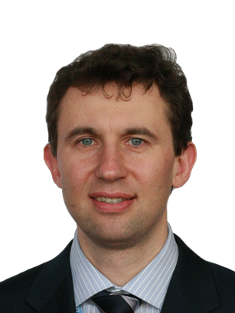
Agenda Item 9.1.6
Issue: a) to assess the impact of WPT for electric vehicles on radiocommunication services;
b) to study suitable harmonized frequency ranges which would minimize the impact on radiocommunication services from WPT for electrical vehicles; concerning Wireless Power Transmission (WPT) for electric vehicles;
Preliminary CEPT position:
Acting CEPT Coordinator: PTD chair

Slide 38
Agenda Item 9.1.7 (developed at CPG PTB#1)
Issue: to examine whether there is a need for possible additional measures in order to limit uplink transmissions of terminals to those authorized terminals in accordance with No. 18.1, and the possible methods that will assist administrations in managing the unauthorized operation of earth station terminals deployed within its territory, as a tool to guide their national spectrum management programme, in accordance with Resolution ITU-R 64 (RA-15);
Preliminary CEPT position:
CEPT supports possible ITU studies on best practices, related to national management of unauthorised operation of earth station terminals deployed within territory of concerned administration.
CEPT doesn’t support to include the results of the studies into the Radio regulations. Furthermore, CEPT believes that this issue is already addressed in Article 18.
Acting CEPT Coordinator: PTB chairperson

Slide 39
Agenda Item 9.1.8
Issue: to study the technical and operational aspects of radio networks and systems, as well as spectrum needed, including possible harmonized use of spectrum to support the implementation of narrowband and broadband machine-type communication infrastructures, in order to develop Recommendations, Reports and/or Handbooks, as appropriate, and to take appropriate actions within the ITU Radiocommunication Sector (ITU-R) scope of work;
Preliminary CEPT position:
CEPT supports studies on the technical and operational aspects of radio networks and systems, as well as spectrum needed, including possible harmonized use of spectrum to support the implementation of narrowband and broadband machine-type communication infrastructures, in order to develop Recommendations, Reports and/or Handbooks, as appropriate.
CEPT supports the consideration of IMT technologies within Agenda Item 9.1 Issue 9.1.8 as well as the consideration of non-IMT technologies in the purview of WPs 1B and 5A related to machine-type communications.
CEPT Coordinator: Vadim Poskakukhin (Russian Federation)

Slide 40
Agenda Item 9.1.9 (developed at CPG PTB#1)
Issue: to conduct studies relating to spectrum needs and possible allocation of the frequency band 51.4-52.4 GHz to the fixed-satellite service (Earth-to-space) GSO feeder links, Including the protection of the RAS, as appropriate;
Preliminary CEPT position:
CEPT is on the view that the demand and justification for additional FSS spectrum should be clarified before possible regulatory actions can be proposed under this agenda item.
CEPT supports studies on evaluation of additional spectrum needs for development of the fixed-satellite service in accordance with resolves to invite ITU‑R 1 of Resolution 162 (WRC‑15).
CEPT considers, that sharing and compatibility studies with existing services, on a primary and secondary basis, including in adjacent bands as appropriate, to determine the suitability of new primary allocations to the FSS in the frequency band 51.4-52.4 GHz (Earth-to-space) limited to FSS feeder links for geostationary orbit use, and the possible associated regulatory actions, are subject to justification resulting from studies conducted under resolves to invite ITU‑R 1 of Resolution 162 (WRC‑15). The passive services in the band 52.6-54.25 GHz shall be protected.
CEPT is of the view that studies carried out under this agenda item should take into account that the band 50.4-52.6 GHz is being considered under WRC-19 agenda item 1.13, noting that frequency band 50.4-51.4 GHz is already allocated to FSS (earth-to-space).
Acting CEPT Coordinator: PTB chairperson

Slide 41
Agenda Item 9.2
Issue: to consider and approve the Report of the Director of the Radiocommunication Bureau, in accordance with Article 7 of the Convention on any difficulties or inconsistencies encountered in the application of the Radio Regulations;
Preliminary CEPT position:
Acting CEPT Coordinator: PTA, PTB and ECC PT1 chair as relevant

Slide 42
Agenda Item 9.3 (developed at CPG PTB#1)
Issue: to consider and approve the Report of the Director of the Radiocommunication Bureau, in accordance with Article 7 of the Convention on action in response to Resolution 80 (Rev.WRC-07);
Preliminary CEPT position:
CEPT follows the ITU-R studies on this aspect.
Acting CEPT Coordinator: PTB chairperson

Slide 43
Agenda Item 10
Issue: to recommend to the Council items for inclusion in the agenda for the next WRC, and to give its views on the preliminary agenda for the subsequent conference and on possible agenda items for future conferences, in accordance with Article 7 of the Convention;
Preliminary CEPT position:
CEPT Coordinator: Pasi Toivonen (Finland),
coordination team: Karsten Buckwitz (G), Wesley Milton (UK)

Slide 44
Next meetings
CPG will meet on 6-9 December 2016, Feusisberg, Switzerland
Its next project team meetings are:
1st PTD: 20-22 September 2016, Rome, Italy
1st PTC: 27-29 September 2016, ECO, Copenhagen
1st PTA: 11-13 October 2016, ECO, Copenhagen
ECC PT1: 16-20 January 2017, Portugal
We look forward to welcoming representatives from the other Regional Organisations to these meetings

Slide 45
Useful links:
General information: http://www.cept.org/ecc
CPG page: http://www.cept.org/ecc/groups/ecc/cpg
Questions/Answers regarding CPG: http://www.cept.org/files/4200/documents/CPG%20role%20in%20WRC%20preparation%20process%2011oct13.pdf
ECC PT1 page:
http://www.cept.org/ecc/groups/ecc/ecc-pt1/client/introduction/
Coordinators:
http://www.cept.org/ecc/groups/ecc/cpg/page/list-of-cept-coordinators-wrc-19/
CEPT Briefs/ECPs:
http://www.cept.org/ecc/groups/ecc/cpg/page/cept-briefs-and-ecps-for-wrc-19

Slide 46
Thank you

